Slide 1
Conversational image recognition chatbot (LiveLens conversational AI Chatbot)
CSE7101- Capstone Project
Review-2
Batch Number: CIT_08
Roll Number | Student Name
20221CIT0051 | ADITHYA K A
20221CIT0007 | ANAND M M
20221CIT0053 | K SAI LAKSHMI
Name of the Program: Review-2
Name of the HoD: Dr.Anandraj S.P
Project Coordinator: Ms. Sterlin Minish T N
Project Reviewer: Dr.D R Densilin Brabin
Name of the School Project Coordinators: Dr. Sampath A K , Dr. Geetha A

Slide 2
Problem Statement Number: PSCS_256
Organization: Presidency University
Problem Statement: Conversational image recognition chatbot
Category : Software
Problem Description: Visually impaired and blind individuals face significant barriers when trying to access and interpret visual information in their daily lives. Many existing image recognition chatbots require users to manually upload images, making them inaccessible or inconvenient for those who cannot navigate visual user interfaces. Additionally, these solutions often rely on text-based interactions, which do not fully address the needs of users who require audio-based communication.
The proposed Conversational Image Recognition Chatbot addresses these challenges by allowing users to capture images directly through a laptop or mobile camera, eliminating the need for manual uploads. The system is fully operated using audio input and provides responses through audio output, making it truly accessible for the visually impaired.
This project removes complex technical barriers, increases independence, and enhances daily life for visually impaired users through an intelligent, voice-based, and camera-enabled assistant.

Slide 3
Content
Problem Statement
Objectives
Background and Related work for title Selection
Analysis of Problem Statement
Innovation or Novel Contributions
Git-hub Link
Timeline of the Project
References

Slide 4
Objective
Develop an accessible chatbot interface that accepts audio input and provides audio output, enabling interaction without visual cues.
Enable real-time image capture through a laptop or mobile phone camera, removing the need for manual image uploads.
Implement advanced image recognition algorithms to identify objects, text, colors, and scenes from captured images accurately.
Create a conversational AI system that can understand and respond to user queries about the visual content in a natural, interactive manner.
Ensure the system is user-friendly and accessible for visually impaired and blind users, enhancing their independence.
Test and validate the chatbot's performance and usability in real-world scenarios with target users to ensure it meets accessibility needs.

Slide 5
Background and Related work’s
Multimodal Fusion for Image and Text Understanding: Many prior works apply deep learning models like CNNs for image feature extraction combined with NLP models (BERT, GPT) for textual analysis, enabling chatbots to interpret images and generate relevant textual responses.
Image Captioning and Question Answering: Several studies utilize datasets like MSCOCO and Flickr30k to train models on image captioning and visual question answering (VQA), equipping chatbots to describe uploaded images or answer user queries based on image content.
Use of Pretrained Architectures: Hybrid architectures combining ResNet, YOLOv8 for object detection, and transformer-based models have been commonly used, enabling robust recognition and conversational capabilities without the need for live camera feeds or voice interaction.
Static Image Uploads over Real-Time Capture: To simplify system complexity and privacy concerns, many works focus on file-based image input rather than real-time camera streaming, allowing users to upload pictures and receive detailed textual analysis in response.
Text-Only Interaction for Accessibility and Efficiency: Several chatbots explicitly avoid voice input/output to reduce computational overhead and enhance accessibility, targeting users in web or mobile environments where microphone or speaker usage may be limited.
Application Domains: These chatbots find key applications in e-commerce for product identification, education for tutoring through image explanations, and accessibility solutions providing visual descriptions to the visually impaired.
Challenges Addressed by Existing Works: Existing literature discusses challenges like generating coherent, context-aware responses from multimodal inputs, managing vocabulary gaps in image description, and preserving user privacy during image uploads.
Data Efficiency with Transfer Learning: Several papers address training on limited datasets by leveraging transfer learning from large pre-trained vision and language models, enabling chatbots to generalize well from smaller, domain-specific image corpora.

Slide 6
Analysis of Problem Statement
How our Project is Different:
Real-Time Image Capture via Built-In Cameras: Unlike conventional chatbots that rely on static image uploads, your project captures live video or images directly from laptop or mobile device cameras, enabling instantaneous environmental awareness.
Full Voice Interaction Support: Your system uniquely integrates both voice input and voice output, allowing users—especially visually impaired ones—to interact naturally without relying on screens or keyboards, unlike most text-only chatbots.
Focused Accessibility for Blind and Visually Impaired Users: Designed specifically to assist blind users, your project delivers spoken descriptions and interactive voice dialogs, providing independence and real-world assistance beyond standard chatbot applications.
Multimodal Fusion in Real Time: The system seamlessly fuses live visual data and speech processing in real time, offering richer, continuous, and context-aware conversations about the user’s environment.

Slide 7
Analysis of Problem Statement
Enhanced Privacy via Real-Time Processing: Real-time on-device or immediate cloud processing minimizes image storage and reduces privacy risks common in systems that save or transmit static images.
Broader and More Practical Use Cases: Beyond answering image queries, your chatbot supports navigation, object recognition, and scene description on the image—capabilities that are limited or missing in static upload-based chatbots.
Improved User Experience: By combining live camera input and voice communication, the project provides a hands-free, intuitive experience that adapts to dynamic real-world scenarios better than traditional chatbot designs.
Software Requirements:
smolvlm for image processing
Whisper for audio input
Kokoro for audio output
Python for architecture
OpenCV for computer vision

Slide 8
Github Link
Link :
https://github.com/Adithya140/pscs_256.git

Slide 9
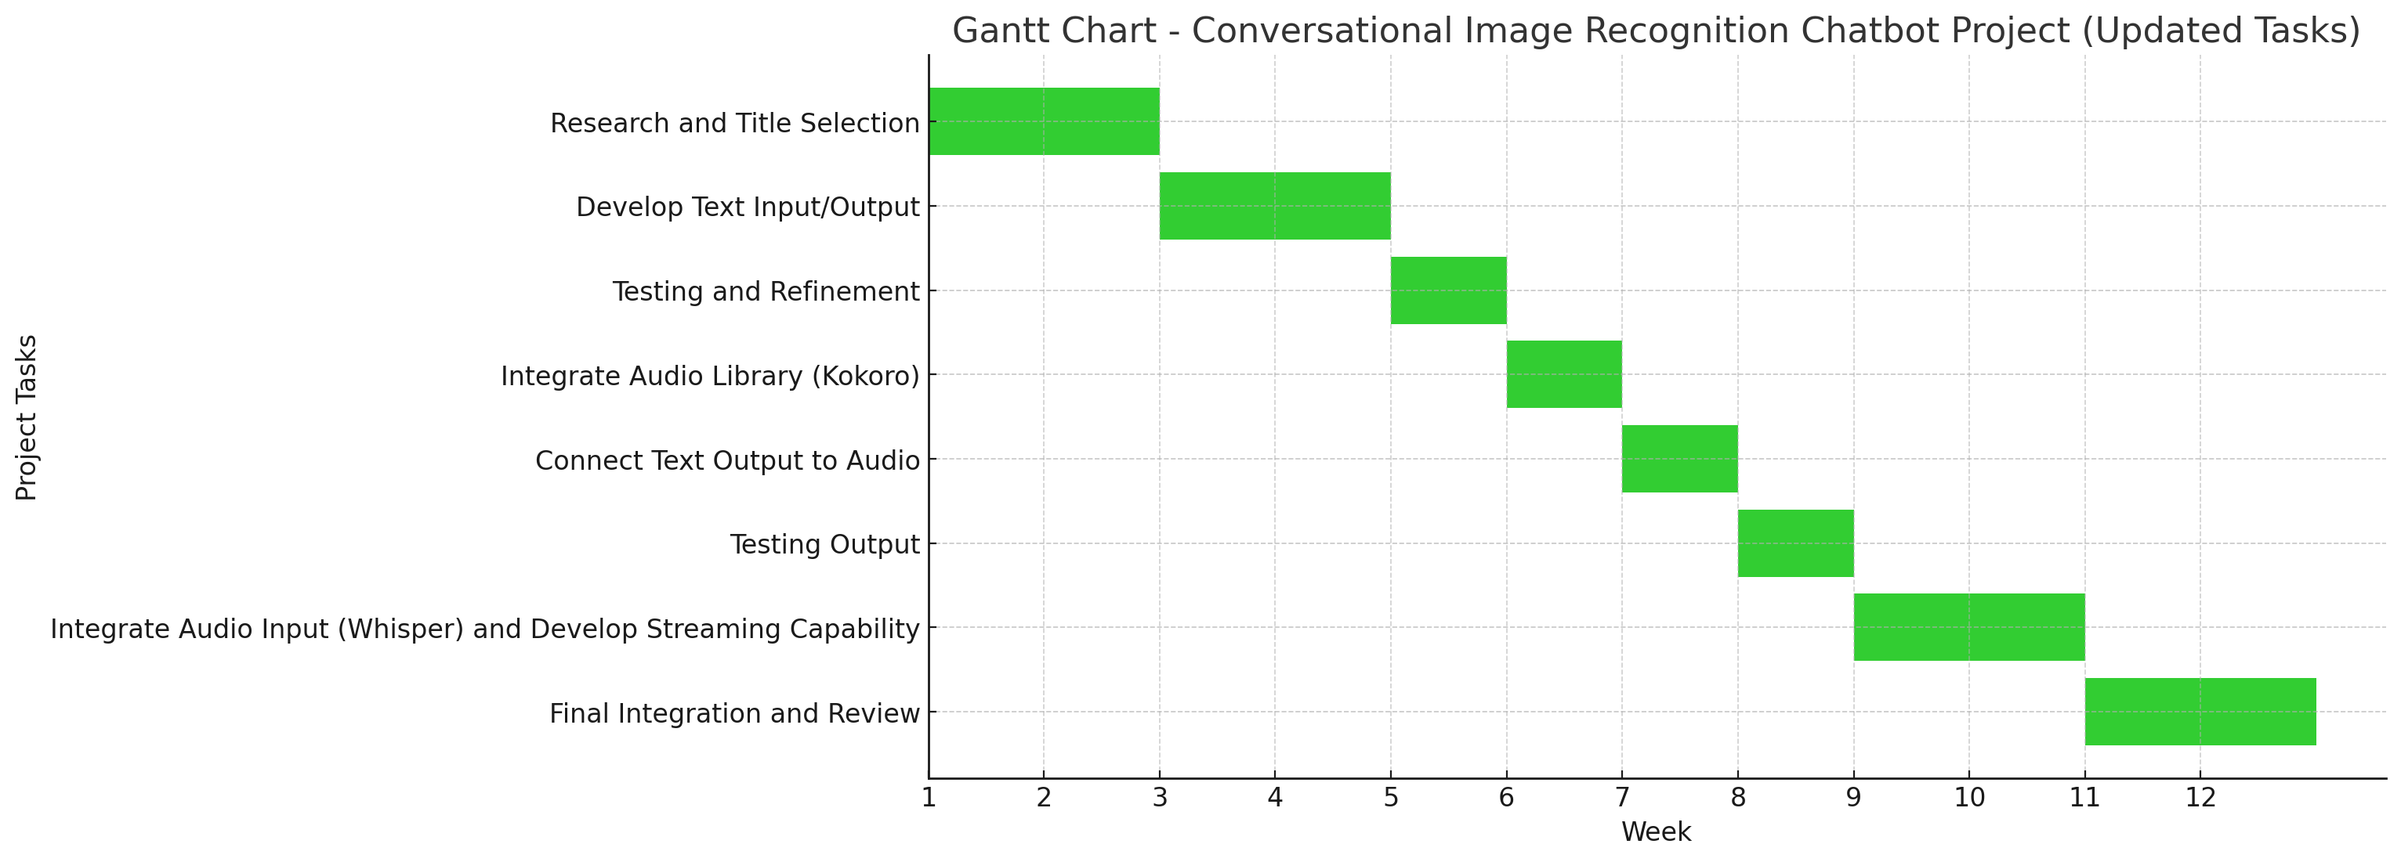
Timeline of the Project (Gantt Chart)

Slide 10
References (IEEE Paper format)
Convolutional and Image Recognition Chatbot - IJIRT https://ijirt.org/publishedpaper/IJIRT169815_PAPER.pdf
Conversational Image Recognition Chatbot - IJPRR https://ijrpr.com/uploads/V6ISSUE5/IJRPR46094.pdf
Conversational Image Recognition Chatbot - IRJMETS https://www.irjmets.com/uploadedfiles/paper/issue_10_october_2024/62967/final/fin_irjmets1730175122.pdf
Conversational Image Recognition Chatbot - IJATEM https://ijatem.com/wp-content/uploads/2024/11/ICRCCT24_001.pdf
Chatbot with Image Upload and Text Interaction - IJEIJournal https://www.ijeijournal.com/papers/Vol13-Issue11/1311133138.pdf
Chatbot AI with Image Generator and MCQ Generator - JETIR https://www.jetir.org/papers/JETIR2406987.pdf
CS230 Final Project: Conversational Image Recognition Chatbot - Stanford http://cs230.stanford.edu/projects_fall_2020/reports/55800280.pdf
Overview of Chatbots with AI Emphasis - PMC https://pmc.ncbi.nlm.nih.gov/articles/PMC10644239/
PicQuest - Image Recognition Chatbot - IJISRT https://www.ijisrt.com/assets/upload/files/IJISRT25APR848.pdf
Image classifying AI Chatbot - IJARIIT https://www.ijariit.com/manuscripts/v7i5/V7I5-1378.pdf

Slide 11


